Slide 1
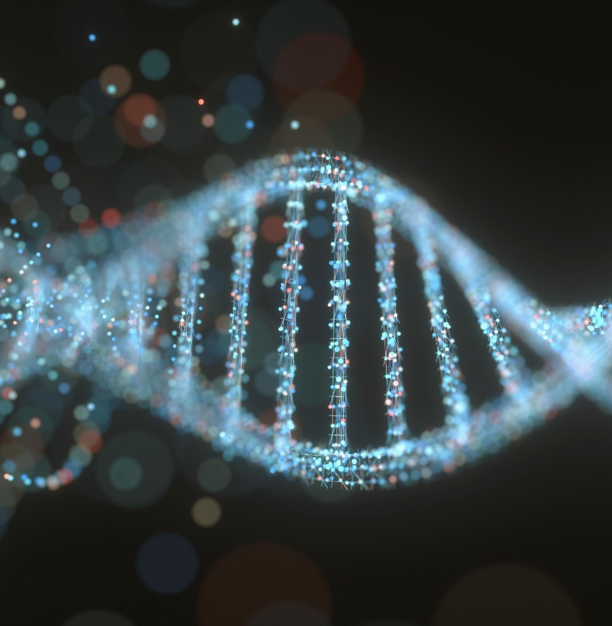

SCI225 · PATHOPHYSIOLOGY
Week Twelve
The Reproductive Systems
Dr. Vidya Aggrawal Nightingale College
// week 12 visual
Notes:
Welcome to Week 12 — the Reproductive Systems. We cover female and male reproductive physiology and the disorders that follow from the hormonal logic.

Slide 2

TODAY'S SESSION
Agenda
01
Female reproductive — cycle & disorders
02
PCOS, endometriosis & menopause
03
Male reproductive — testicular & prostate
04
Knowledge checks & discussion
SCI225 · WEEK 12
02 / 26
Notes:
Today's agenda — female system, male system, and clinical application.

Slide 3
WEEK TWELVE
Learning objectives
1
Recall the structure, function, and hormonal control of the female reproductive system.
2
Describe alterations of female and male reproductive function and their consequences.
3
Discuss the clinical manifestations of common reproductive disorders.
SCI225 · WEEK 12
03 / 26
Notes:
Three weekly learning objectives.

Slide 4
Weekly resources
Required reading
Clinical tools
Female reproductive structure & alterations chapter
Male reproductive structure & alterations chapter
Week 12 Study Guide — covers all objectives
PCOS diagnostic criteria overview
Torsion vs. epididymitis quick reference
Reproductive cheat sheet — highest-yield patterns
Supplemental
Menstrual cycle hormone diagram
Scrotal pain differential refresher
SCI225 · WEEK 12
04 / 26
Notes:
Required reading and resources.

Slide 5

12
MODULE TWELVE
Week Twelve
The reproductive systems — the menstrual cycle and its disorders, PCOS and endometriosis, testicular emergencies, and prostate disease.
SCI225 · WEEK 12
05 / 26
Notes:
Open Module 12 — Week Twelve.

Slide 6
ACTION ITEMS
What is due this week?
Week 12 Pre-Assessment — complete before the webinar.
Discussion — apply reproductive pathophysiology to a clinical scenario; initial post + 2 peer replies.
Webinar Quiz — covers the menstrual cycle, PCOS, scrotal emergencies, and prostate disease.
Case Study — apply hormonal logic to a patient presentation.
Webinar — PCOS, endometriosis, testicular torsion, and BPH. Bring your reading notes.
SCI225 · WEEK 12
06 / 26
Notes:
What is due this week.

Slide 7
SECTION · FEMALE REPRODUCTIVE SYSTEM
Section objective
1
Recall the menstrual cycle and its hormonal control, then trace the disorders of ovulation, structure, infection, and menopause back to that hormonal logic.
SCI225 · WEEK 12
07 / 26
Notes:
Section 1 objective — female reproductive system.

Slide 8
The menstrual cycle & hormonal control
A hormonal relay: hypothalamus → pituitary → ovary → uterus
Hormone (source)
Job
GnRH (hypothalamus)
Triggers the pituitary to release FSH & LH; rises at puberty
FSH (pituitary)
Stimulates ovarian follicles to mature
LH (pituitary)
The LH surge triggers ovulation
Estrogen (follicle)
Builds up (proliferates) the endometrium
Progesterone (corpus luteum)
After ovulation, maintains/stabilizes the endometrium for possible pregnancy
Memory hook: FSH grows the egg · LH "launches" ovulation · corpus luteum = progesterone = "pro-gestation."
SCI225 · WEEK 12
08 / 26
Notes:
The menstrual cycle — the hypothalamus-pituitary-ovary-uterus relay.

Slide 9
Across the cycle — progesterone is the "stay" hormone
→
→
→
01
02
03
04
Follicle matures
LH surge → ovulation
Corpus luteum
Menstruation
FSH matures a follicle → estrogen rises → endometrium thickens.
Ruptured follicle makes progesterone to hold the lining.
No pregnancy → progesterone falls → lining loses support and sheds.
Egg released; fertilization usually in the fallopian tube (ampulla).
Key idea: progesterone withdrawal removes endometrial support → the lining breaks down and sheds.
SCI225 · WEEK 12
09 / 26
Notes:
Progesterone is the stay hormone — its withdrawal triggers menstruation.

Slide 10
Menstrual & ovulatory disorders — PCOS
The PCOS chain
Other disorders
Insulin resistance → high insulin
High insulin → excess ovarian androgens
Androgens disrupt the LH surge
→ chronic anovulation → infertility, acne, hirsutism
Primary dysmenorrhea: high prostaglandins → cramping + ↓ uterine blood flow
Abnormal uterine bleeding: anovulation → no progesterone → lining overgrows then sheds irregularly
Amenorrhea: absent periods — hormonal or structural
Monitor in PCOS: endometrial cancer (unopposed estrogen) and type 2 diabetes (insulin resistance).
SCI225 · WEEK 12
10 / 26
Notes:
Menstrual and ovulatory disorders — PCOS, dysmenorrhea, abnormal bleeding.

Slide 11
Structural & proliferative disorders
Disorder
What it is
Consequence
Endometriosis
Ectopic endometrial tissue outside the uterus that still responds to cyclic hormones
Cyclic bleeding → inflammation, pelvic adhesions, pain, infertility
Uterine fibroids (leiomyoma)
Benign smooth-muscle tumors of the uterus
Heavy bleeding, bulk/pressure symptoms
Endometrial hyperplasia / cancer
Overgrowth from prolonged estrogen without progesterone
Abnormal bleeding; can progress to cancer
Androgen insensitivity
Genetically male, body can't respond to androgens; no uterus develops
No menstruation (no endometrium to shed)
Key idea — unopposed estrogen: estrogen builds the lining; progesterone controls it. Estrogen for a long time without progesterone → hyperplasia → endometrial cancer.
SCI225 · WEEK 12
11 / 26
Notes:
PCOS in depth — insulin resistance to anovulation.

Slide 12
Infections, PID & menopause
Topic
Mechanism
Vaginitis
Disrupted flora / raised vaginal pH lets microorganisms overgrow
Douching
Washes out protective flora → ↑ pH → infection risk
Postmenopausal vaginitis
Low estrogen thins/atrophies the lining and raises pH → infection risk
PID → ectopic pregnancy
Infection scars the fallopian tubes → egg implants in the tube
Menopause
Ovarian estrogen declines → cycles stop; atrophy, vasomotor symptoms, bone loss
Pearl: estrogen keeps the vagina acidic and protective. Less estrogen (menopause) or washed-out flora (douching) → higher pH → more infections.
SCI225 · WEEK 12
12 / 26
Notes:
Structural and proliferative disorders — endometriosis, fibroids, hyperplasia.

Slide 13
KNOWLEDGE CHECK
Question 1
The corpus luteum degenerates and progesterone falls. Which mechanism leads to menstruation?
A
Loss of endometrial support causing tissue breakdown
B
Rising estrogen thickening the lining
C
An LH surge triggering ovulation
D
Increased progesterone stabilizing the lining
SCI225 · WEEK 12
13 / 26
Notes:
Infections, PID, and menopause.

Slide 14
KNOWLEDGE CHECK
Question 2
Which pathophysiologic mechanism best explains chronic anovulation in PCOS?
A
Excess insulin raises androgens and disrupts the LH surge
B
Excess insulin promotes normal follicular maturation
C
Low androgens prevent follicle growth
D
High progesterone blocks ovulation
SCI225 · WEEK 12
14 / 26
Notes:
Knowledge check — progesterone withdrawal.

Slide 15
KNOWLEDGE CHECK
Question 3
A patient with a history of PID is at increased ectopic pregnancy risk. Which change explains it?
A
Fallopian tube scarring blocking normal egg transport
B
Thickened endometrium
C
Increased ovarian reserve
D
Elevated progesterone
SCI225 · WEEK 12
15 / 26
Notes:
Knowledge check — PCOS anovulation.

Slide 16
SECTION · MALE REPRODUCTIVE SYSTEM
Section objective
2
Describe male reproductive physiology and its disorders — scrotal emergencies, prostate disease, and erectile dysfunction.
SCI225 · WEEK 12
16 / 26
Notes:
Knowledge check — PID and ectopic pregnancy.

Slide 17
THREE JOBS
Male physiology, sperm & aging
Testes (Leydig cells): produce testosterone; sperm form in the seminiferous tubules.
Epididymis: sperm mature and gain motility here.
Sperm flagellum (tail): provides motility; tail dysfunction → impaired sperm movement.
Erection is a vascular event — arterial inflow fills the erectile tissue while venous outflow is restricted to trap it.
Aging: testosterone gradually declines → ↓ libido, ↓ muscle mass, slower sperm production, more erectile and prostate issues.
SCI225 · WEEK 12
17 / 26
Notes:
Section 2 objective — male reproductive system.

Slide 18
Testicular & scrotal disorders
Disorder
Mechanism / clues
Testicular torsion
Spermatic cord twists → ischemia. Sudden, severe pain, nausea, high-riding testicle. Surgical emergency.
Epididymitis
Often STI; gradual pain/swelling + burning urination (dysuria)
Orchitis
Testicular inflammation, classically after a viral illness (mumps) → fever + painful swelling
Varicocele
Dilated scrotal veins → pooled blood raises temperature → reduced sperm quality
Cryptorchidism
Undescended testis → ↑ risk of infertility and testicular cancer
Key idea: torsion = sudden ischemic pain, high-riding testicle (minutes matter); epididymitis = gradual pain with STI and dysuria. Timing + dysuria separate them.
SCI225 · WEEK 12
18 / 26
Notes:
Male physiology — testosterone, sperm, erection as a vascular event.

Slide 19
Prostate disorders — BPH vs. cancer
BPH
Prostate cancer
Benign enlargement — very common with aging
Enlarged prostate compresses the urethra
Hesitancy, weak stream, incomplete emptying, nocturia
Malignant growth, often peripheral
Tumor compresses/obstructs the urethra (often later)
May be asymptomatic early; can metastasize to bone
Key idea: the urinary symptoms of both come from the same mechanism — the enlarged prostate compressing the urethra. Cancer must be ruled out (exam, PSA).
SCI225 · WEEK 12
19 / 26
Notes:
Testicular and scrotal disorders — torsion versus epididymitis.

Slide 20
A VASCULAR PROBLEM
Erectile & sexual dysfunction
Vascular ED: reduced arterial inflow can't fill the erectile tissue — atherosclerosis, diabetes, hypertension. Often the first sign of systemic vascular disease.
Priapism: prolonged, unwanted erection → trapped blood becomes deoxygenated → ischemia damages erectile tissue → later ED.
Key idea: vascular ED = not enough inflow (a "pipe" problem). Priapism is the opposite — blood gets stuck, goes ischemic, and the damage causes later ED, which is why prolonged priapism is an emergency.
SCI225 · WEEK 12
20 / 26
Notes:
Prostate disorders — BPH versus cancer.

Slide 21
KNOWLEDGE CHECK
Question 4
A patient has impaired sperm motility. Dysfunction of which structure best explains this?
A
The sperm flagellum (tail)
B
The prostate gland
C
The seminal vesicle duct
D
The bladder neck
SCI225 · WEEK 12
21 / 26
Notes:
Erectile and sexual dysfunction.

Slide 22
KNOWLEDGE CHECK
Question 5
A 17-year-old has sudden severe unilateral scrotal pain during sports, nausea, and a testicle positioned higher than the other. Which process explains this?
A
Spermatic cord twisting cutting off blood supply (ischemia)
B
Gradual STI-related inflammation
C
Dilated scrotal veins raising temperature
D
Post-viral testicular inflammation
SCI225 · WEEK 12
22 / 26
Notes:
Knowledge check — sperm motility.

Slide 23
KNOWLEDGE CHECK
Question 6
An older adult reports urinary hesitancy, a weak stream, and incomplete bladder emptying. What is the cause?
A
An enlarged prostate compressing the urethra
B
Bladder muscle hypertrophy increasing flow
C
Urethral widening
D
Decreased prostate size
SCI225 · WEEK 12
23 / 26
Notes:
Knowledge check — testicular torsion.

Slide 24
KNOWLEDGE CHECK · SELECT ALL THAT APPLY
Question 7
A 28-year-old with PCOS asks what she should be monitored for over time. Which long-term risks are increased by her anovulation and insulin resistance?
A
Endometrial hyperplasia / cancer (unopposed estrogen)
B
Type 2 diabetes mellitus
C
Infertility from chronic anovulation
D
Premature menopause from high progesterone
E
Metabolic syndrome & cardiovascular risk
SCI225 · WEEK 12
24 / 26
Notes:
Knowledge check — prostate obstruction.

Slide 25
“
Choose one reproductive disorder — PCOS, endometriosis, testicular torsion, or BPH — and trace it from the underlying hormonal or structural mechanism to the patient's presenting symptoms. How would understanding that mechanism shape your nursing assessment and teaching?
DISCUSSION PROMPT — WEEK 12
SCI225 · WEEK 12
25 / 26
Notes:
Discussion — applying reproductive pathophysiology.

Slide 26
“
Get the hormonal sequence — FSH grows, LH launches, progesterone holds — and almost every reproductive disorder becomes predictable. The same logic that explains a normal cycle explains why it breaks.
DR. VIDYA AGGRAWAL · PATHOPHYSIOLOGY COURSE INSTRUCTOR · NIGHTINGALE COLLEGE
SCI225 · WEEK 12
26 / 26
Notes:
Closing — the hormonal logic ties it together.

